Slide 1


SmartQuest

Slide 2
Survey
We Surveyed 139 Students
89%

Slide 3
Partners
Stayed bookings per month | Our commission
0-500 | 6.25% - 12%
501 or more | 10% - 14%

Slide 4
Annual Profit Plan
Average hotel of $112 per night
📅 100 bookings per month → yearly revenue of $60,480
🗓 500 bookings per month → would result in yearly revenue of
$302,400

Slide 5
Starting Locally
SmartQuest Timeline
Targeting Colleges and Universities in Western, New York.
Student body of approximately 66,000 students
Future Growth
GOAL: to grow into other highly populated university communities around the country
12 million college students under age 25 in the USA.

Slide 6
Our Customers
User Acquisition Model
Low initial start-up costs
Higher marketing budget
Launch business within 6 months

Slide 7
Why Choose SmartQuest?
Safety
Affordable
Rewards System
Competitors Lack Unique Function

Slide 8
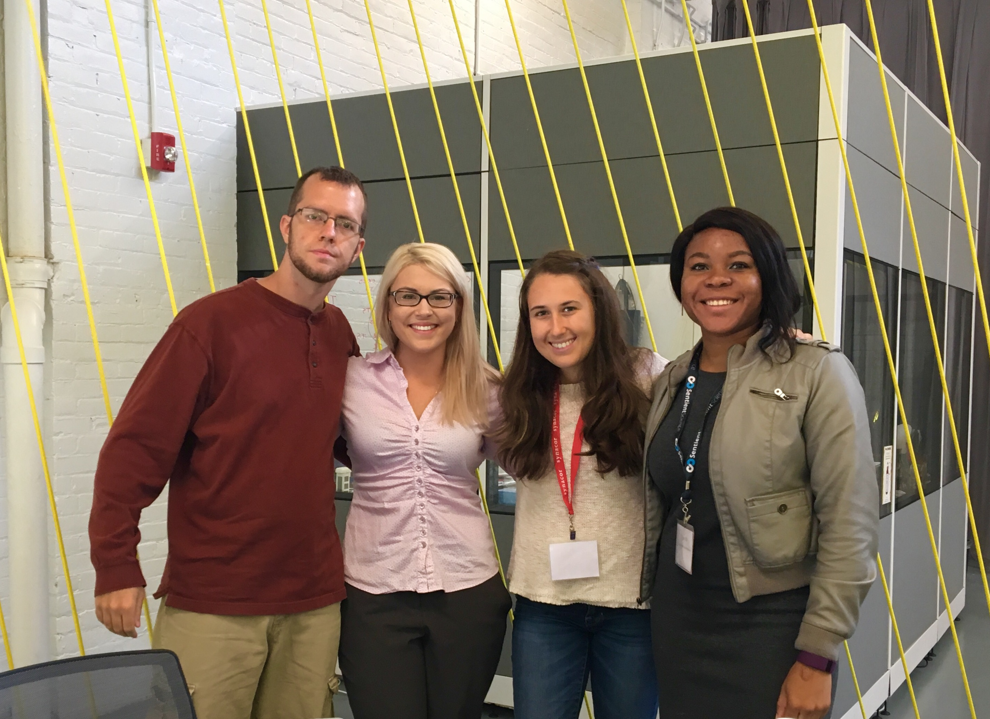
SmartQuest

